Slide 1


King County House Price Analysis
City University of Seattle
CS612 Summer 2020
Group Members:
Anil Erturk erturkanil@cityuniversity.edu
Minh Nguyen minh.truong@cityuniversity.edu
Faculty Advisor: Professor Brian Maeng

Slide 2
Introduction
House price analysis (HPA) has many benefits to consumers and suppliers (real estate investors and construction companies).
HPA prevents consumers from overpaying and suppliers from underpricing.
HPA allows suppliers to figure out what type of houses (features) are in demand.

Slide 3
Introduction
HPA shows the relationship (correlation) between house attributes and price.
HPA also shows the distribution (popularity) of values for each attribute.

Slide 4
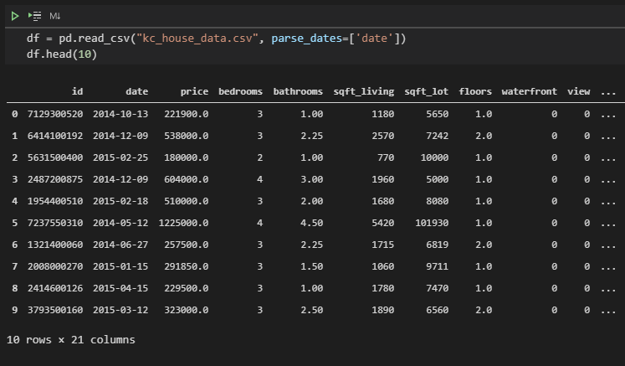
Data
Data was taken from Kaggle as a CSV file and it contains 21614 records. Each record has 21 columns including id (primary key). 20 columns containing useful data.
The two-dimensional data is imported to python as a DataFrame and it uses 3.5 MB.

Slide 5
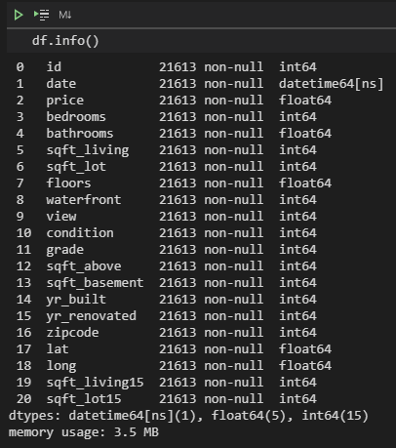
Data
Data only contains numerical values. Some are integer (nominal and ordinal), some are floating-point.
"waterfront" is a nominal binary variable.
"bedroom" is an ordinal variable.

Slide 6
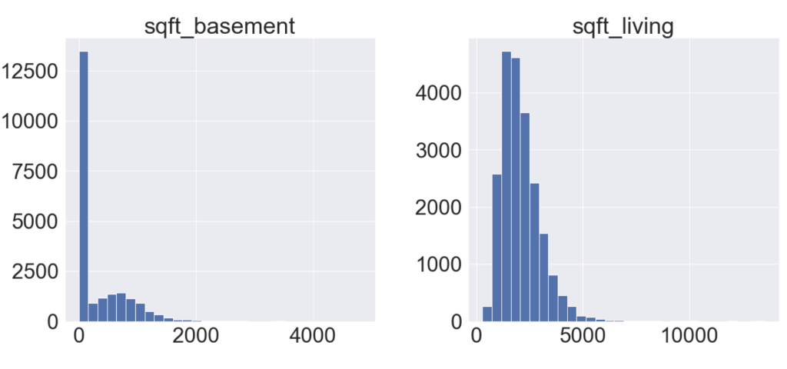
Data
Most features have a normal distribution, only "sqft_basement" having a high concentration around zero. This might suggest that there is a disproportionate number of properties that do not include a basement.

Slide 7
Literature Review
The desire to get a good deal when buying or selling real estate has always driven the need for house price analysis. This analysis shows the value of other real estates with similar features, therefore determining the value of this real estate.
The features that are analyzed are similar in all house price analysis studies since the variables for houses are similar in different times and locations.

Slide 8
Methodology
First step is feature engineering by deriving new variables such as "age" and "renovated" based on old variables.
Next step is removing unnecessary variables.
Then, we look into the relationship between variables. The goal is to determine which columns have an impact on the price column as well as how they impact the price column.
Finally, we will use scatterplot, boxplot, and violin plot to dive deeper into the relationship between price and each feature.

Slide 9
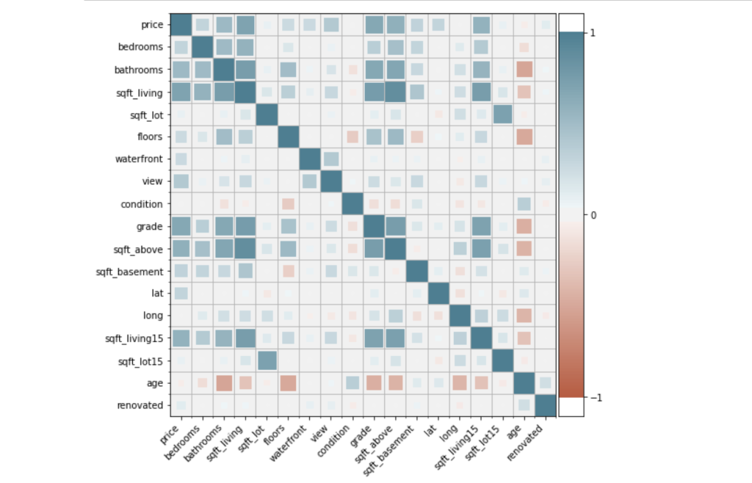
Result
We first use the correlation matrix to look for any notable correlation between each variable with the price of the house.

Slide 10
Result
From this correlation map, we can infer two things.
First, features relating to size seems to influence the price of the house the most.
Features relating to the quality of the house such as age or condition has very little influence on the price.

Slide 11
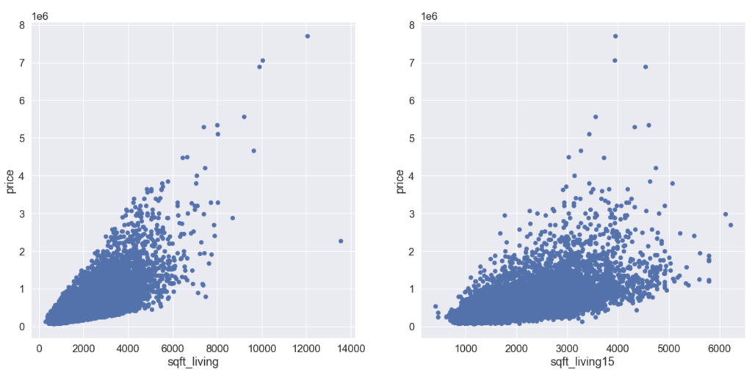
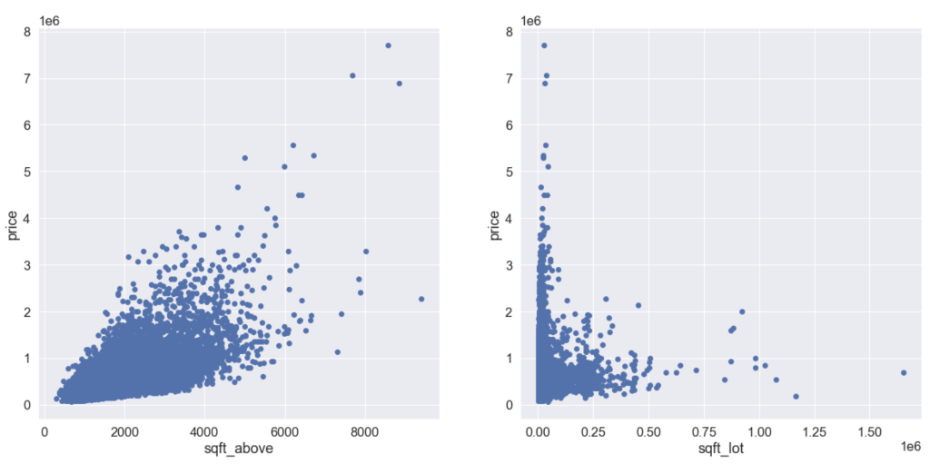
Result
That was the correlation part of our analysis. Now we take a look at distribution of values for different continuous variables.
Other than sqft_lot, there seems to be a trend between price and these features.

Slide 12
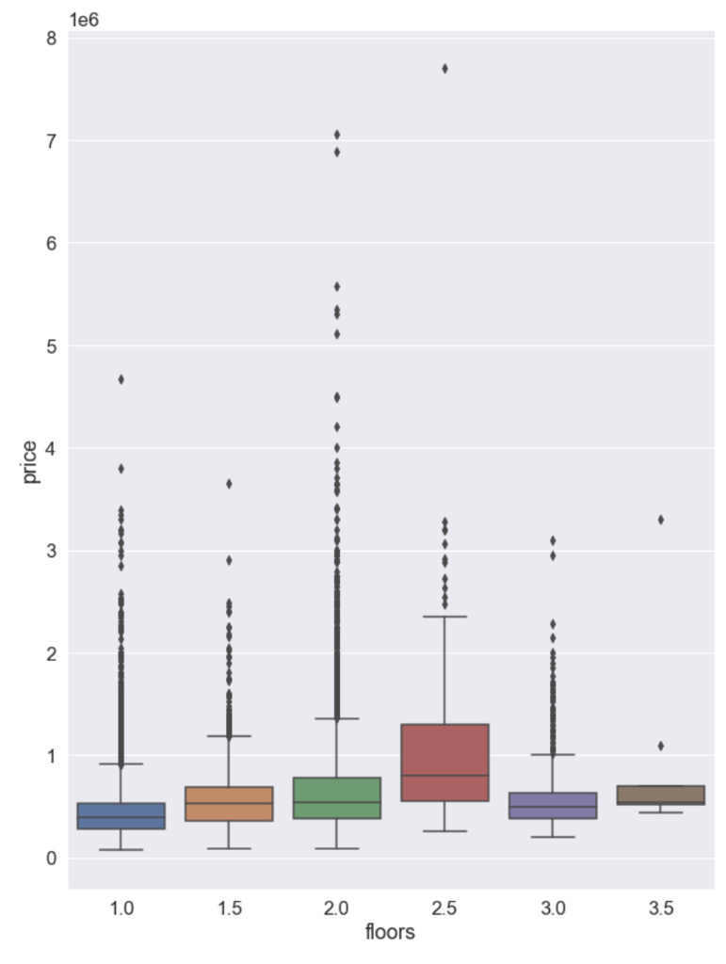
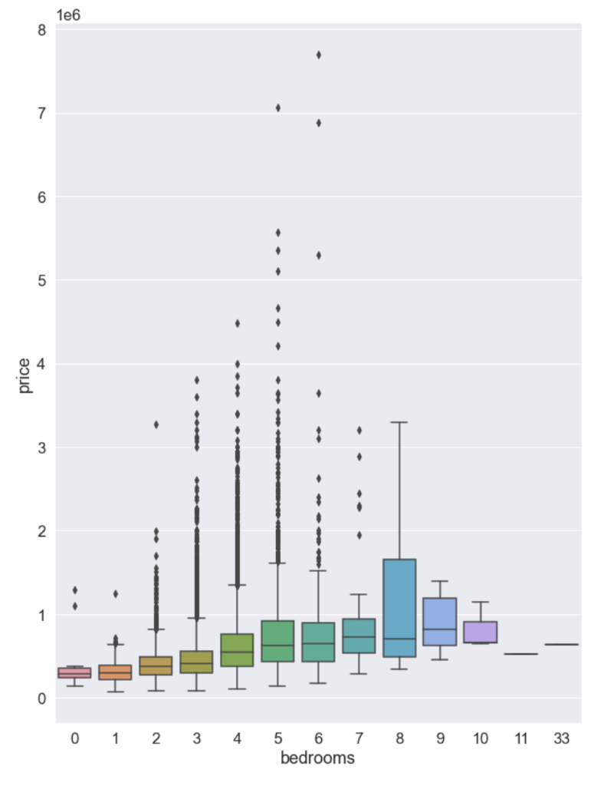
Result
Now we visualize discrete variables.
We can see there is a gradual increase in price for bedroom number but not floor number.

Slide 13
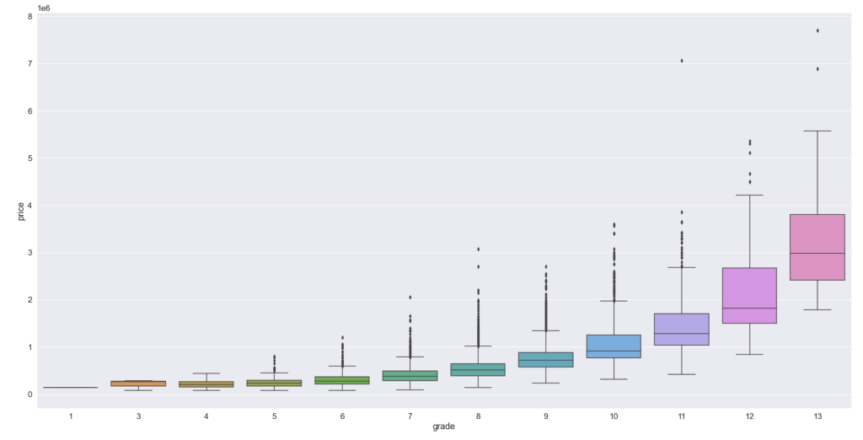
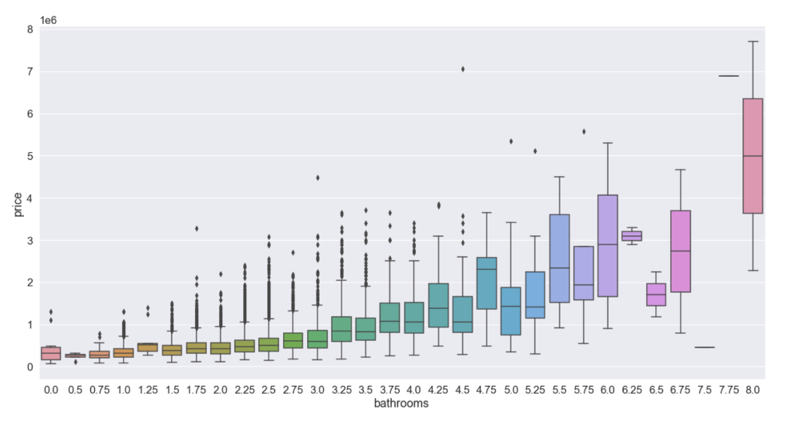
Result
We can see there is a gradual increase in price for bathroom number and grade.
We can infer that the size of the house does have an influence on its price.

Slide 14
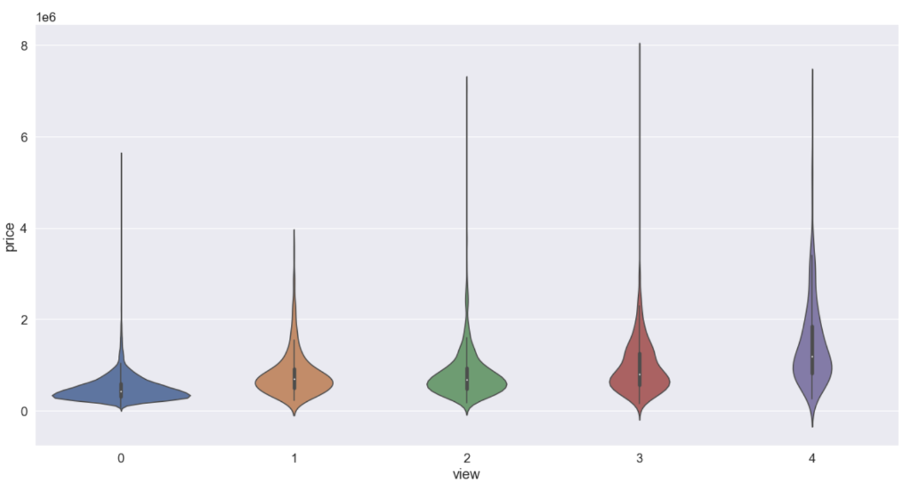
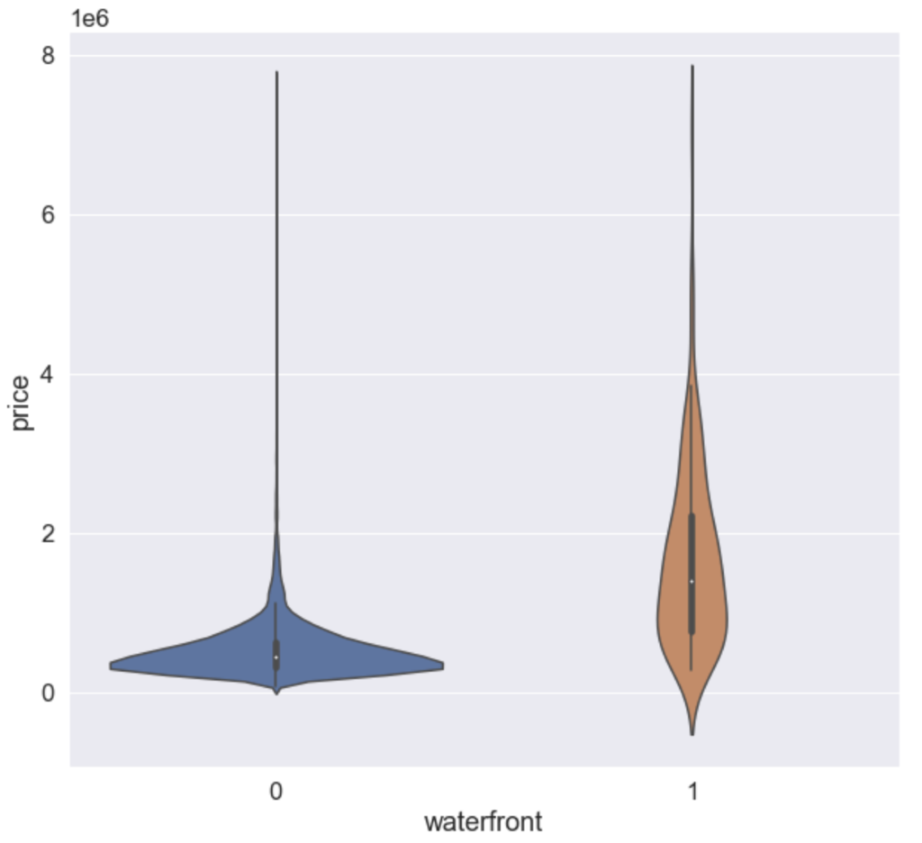
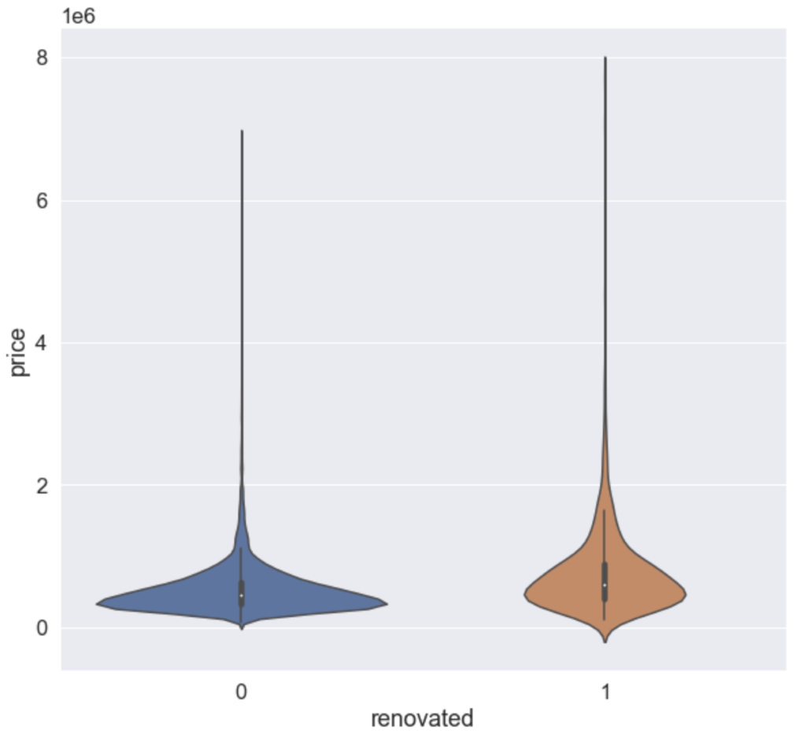
Result
Now we use violin plot to examine other qualitative features.
We can infer that the size of the house does have an influence on its price.

Slide 15
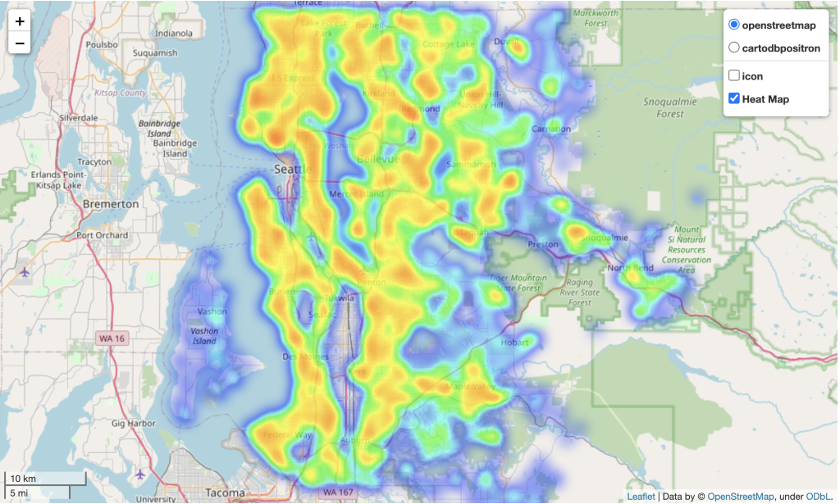
Result
We can also leverage two features "lat" and "long" to visualize how the location has an impact on price using heatmap from folium package.

